Slide 1
ITIL® Foundations
Introduction to the IT Infrastructure Library
Service Delivery
Service Level Management
michel.munhoz@fatec.sp.gov.br

Slide 2
Unit 08: Service Level Management
Contents
  Goals and Objectives
  Key Terms
  Activities
  Inputs and Outputs
  Benefits and Challenges
  Key Performance Indicators (KPIs)
  Summary

Slide 3
Service Delivery: The Tactical Processes
Customers & Users
-Inquiries
-Communication -Reports and updates
-Security plans -Intrusion prevention -Security event logging
Information Security Management
Service Level Management
-SLAs, OLAs, SLRs, UCs -Service catalog -Requirements, targets, achievements
Availability Management
Capacity Management
IT Financial Management
IT Service Continuity Management
-Availability plan -Targets / thresholds -Reports -AMDB
-Capacity plan -Targets / thresholds -Reports -CDB
-Financial plan -Types & models -Costs & charges -Budget & forecasts
-IT continuity plan -BIA & risk analysis -Define requirements -Disaster recovery contracts
Alerts, Exceptions & Changes
System Management Tools
IT Infrastructure
Source: W. Cook
Used with permission.
Notes:
This diagram illustrates the major interfaces and deliverables within the Service Delivery processes.
Service Level Management
Make clear agreements with the customer about type and quality of IT services to be delivered and implement these agreements.
Availability Management
Ensure the appropriate deployment of resources, methods and techniques, to support the availability of IT services agreed with the customer.
Capacity Management
Optimize the cost, timing of acquisition, and deployment of IT resources, to support agreements made with the customer.
Financial Management
Addresses the prudent provision of IT services.
IT Service Continuity Management
Addresses the preparation and planning of disaster recovery measures for IT services in the event of a business interruption.
Security Management
Protects the value of information in terms of confidentiality, integrity and availability.

Slide 4
Service Level Management
Goals and Objectives
  Align IT services with business needs
  Maintain and improve IT service quality
  Improve relationship between IT Services and Customers
Notes:
Service Level Management is the name given to the processes of planning, coordinating, drafting, agreeing, monitoring, and reporting on Service Level Agreements (SLA), and the ongoing review of service achievements to ensure that the required and cost-justifiable service quality is maintained and gradually improved. SLAs provide the basis for managing the relationship between the Provider and the Customer.
Service Level Management (SLM) is essential in any organization so that the level of IT service needed to support the business can be determined, and monitoring can be initiated to identify whether the required service levels are being achieved - and if not, why not. Service Level Agreements (SLA), which are managed through the SLM Process, provide specific targets against which the performance of the IT organization can be judged.
Service Level Management (SLM) is responsible for the qualitative and quantitative management of the services provided by the IT organization to its customers. An essential element in the Service Level Management process is the Service Level Agreement (SLA), a "contract" between the IT organization and its customers, that specifies the services to be delivered. Qualitative as well as quantitative details such as performance and availability of those services are specified within the SLA. An SLA is important for the judgment and execution of most activities in the IT organization. Due to organizational and cultural effects, the SLM process is one of the most important but also the most complex. It formalizes the relationship between the Customer organization and the IT organization.

Slide 5
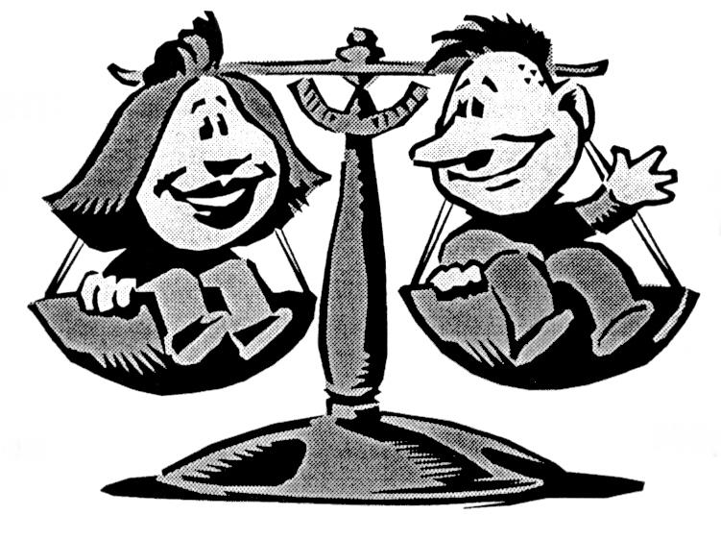

Service Level Management
Balance IT Service Requirements and Capabilities
Customer Requirements for IT Services
IT Service Provider Capabilities
Price
Convenience
Satisfaction
Cost
Effectiveness
Efficiency

Slide 6
Service Level Management
Key Terms
Service Level Agreement (SLA)
An agreement between IT service provider and the IT customer, detailing key service targets and responsibilities of both parties
Operational Level Agreement (OLA)
An agreement between IT service provider and other internal departments or organizations. OLAs commit these groups to a role in supporting an SLA
Underpinning Contract (UC)
A contract with an external organization who plays a role in the delivery of IT services and therefore can affect the achievement of an SLA
Notes:
An SLA is a written agreement between an IT service provider and the IT customer(s), defining the key service targets and responsibilities of both parties. The emphasis must be on agreement, and SLAs should not be used as a way of holding one side or the other to ransom. A true partnership should be developed between the IT provider and the customer, so that a mutually beneficial agreement is reached, otherwise the SLA could quickly fall into disrepute and a culture of blame prevent any true service quality improvements from taking place.
To define the service which a IT organization should provide, an SLA is a mandatory contract. To ensure delivery of service, the IT organization needs an underpinning contract with its suppliers.

Slide 7
Service Level Management
Key Terms (Continued)
Service Catalog
A “menu” of all standard IT services and their features
Service Level Requirement (SLR)
A list of all customer requirements for the service
Service Specifications
A document that connects the service functionality (customer focused) with the supporting technicalities (IT provider focused)
Service Improvement Program (SIP)
A formal project that focuses on customer satisfaction and IT service quality issues
Notes:
The Service Specifications detail what the customer wants (externally focused) with what consequences this has for the service provider (internally focused), such as required resources and skills.

Slide 8
Service Level Management
What, When, Who
SLA Contents (at a minimum)
  Simple description of the service and deliverables
  The agreed service hours
  Incident response times and resolution times
  Service availability, security and continuity targets
  Customer and Provider responsibilities
  Critical business periods and exceptions (holidays, etc.)
  Next SLA review date
All targets contained in an SLA should be capable of being monitored and measured

Slide 9
Service Level Management
Activities
  Negotiate SLA with Customer
    Document service requirements and expected service characteristics in the SLA
    Coordinate supporting agreements (OLA, UC)
  Measure and report
    Actual service level achievements versus targets
    Customer reports and IT organization reports
  Continuously improve service levels
    Review SLAs to ensure alignment with customer needs
    Implement Service Improvement Programs (SIP)
  Produce, review and maintain the Service Catalog

Slide 10
Service Level Management
Service Level Requirements (SLR) from Customer
Service Catalog from SLM “menu of all services”
Negotiation: SLM and Customer
Detailed Service Specifications
Service Level Agreement (SLA)
Operational Level Agreement (OLA) – Internal Organization
Underpinning Contract (UC) – External Organization

Slide 11
Service Level Management
  Inputs
      Business and Customer IT service requirements (SLRs)
        Vital business functions, availability, continuity, performance
      IT capacity thresholds
      Performance and achievement data
      Customer surveys
  Outputs
      SLAs, OLAs and UCs
      Service Catalog
      Service Improvement Program
      Performance and achievement reports

Slide 12
Service Level Management
Benefits
  Improved relationship between Customer and the IT service provider – clear understanding of expectations
  Better alignment of IT service characteristics with the business needs
  Focus on services quality leads to continuous improvement
  Improvements in IT service quality lead to reduced outages and financial savings

Slide 13
Service Level Management
Challenges
  SLAs based on desires rather than measurable and achievable targets
  Inadequate resources and time
  SLAs not supported by adequate UCs and OLAs
  Unclear definition of responsibilities of each party
  IT focused rather than business-aligned
  Unclear business requirements
Notes:
The costs for SLM should be viewed as an investment resulting in a significant financial return.
• Staff salaries, training
• Consultancy, initial and ongoing
• Support tools and hardware
• Marketing costs

Slide 14
Service Level Management
Key Performance Indicators
  How many services are covered by SLAs?
  How frequently are SLA review meetings held?
  Are Service Improvement Programs in use?
  Are service breaches being explored?
  Are service level achievements improving?
  Are Customer perception statistics improving?
Notes:
Implementation Considerations
• Show how SLAs contribute to business success
• Clearly differentiate Service Level Management (Process) from Service Level Agreements (Contract)
• Charge on SLA basis for services used rather than globally
• SLA contains clear definitions for all parties in clear language
• Define SLAs as one of the activities of the Service Level Management process
• Each SLA should be supported by its own OLAs and UCs

Slide 15
Service Level Management
Summary
  Maintain and improve business-aligned IT service quality
  Set expectations for realistic and measurable service levels
  Responsibilities include negotiate SLAs, review SLAs, create and maintain Service Catalog, coordinate OLAs and UCs, implement SIPs, and reporting
  SLA includes service description, availability and performance expectations, next SLA review date
  OLA for internal organizations that support SLA
  UC for external organizations that support SLA
  IT services support the success of the business!

Slide 16
Service Level Management
Review and Discussion
  What are the goals of Service Level Management?
  What are the activities of Service Level Management?
  What are the differences between an SLA, OLA, and UC?
  What document lists the customer’s service requirements?
  Why is a service catalog important?
  What are some fundamental content items in an SLA?

